Slide 1

INFM 603: Information Technology and Organizational Context
Session 1: Physical and Web Infrastructure
Jimmy Lin
The iSchool University of Maryland
Thursday, September 6, 2012

Slide 2
A brief history… (How computing got here)

Slide 3
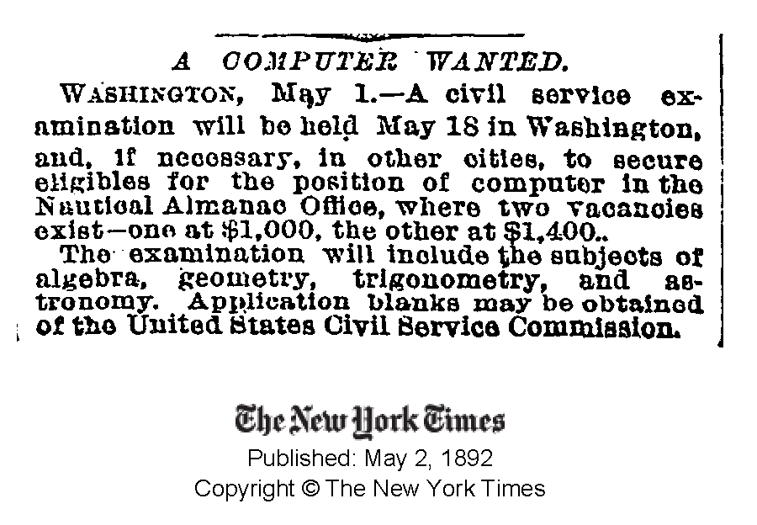

Slide 4
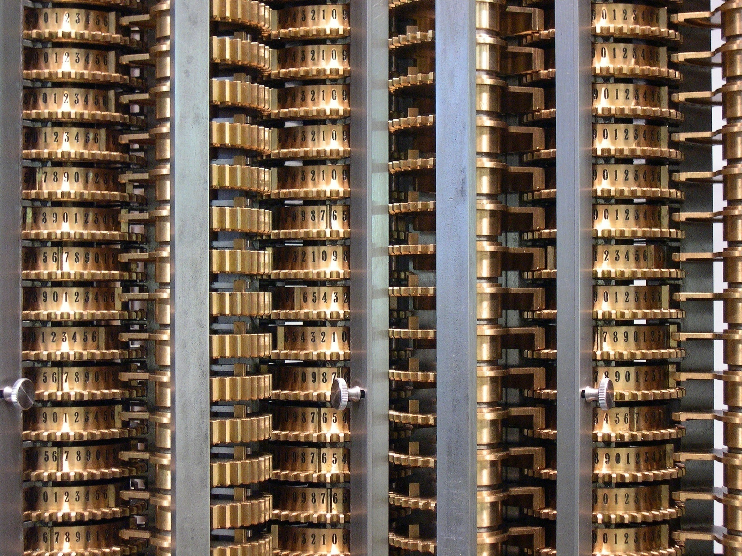
Source: Wikipedia (Difference engine)

Slide 5

Source: Wikipedia (ENIAC)

Slide 6
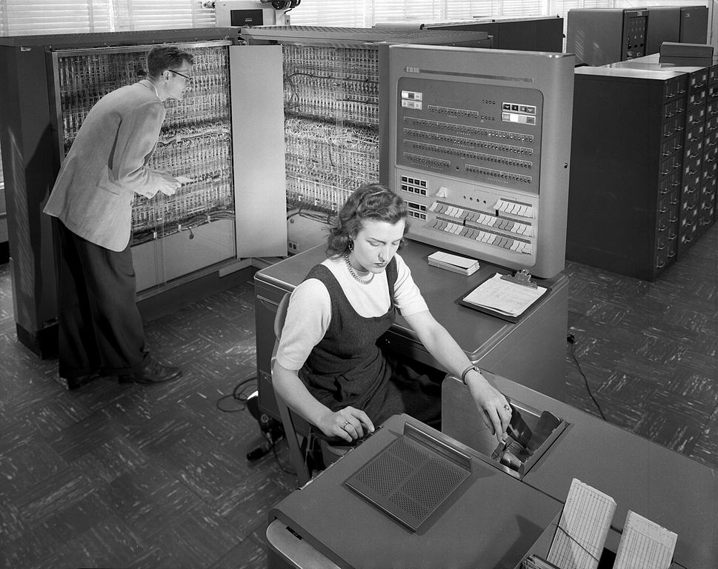
Source: Wikipedia (IBM 704)

Slide 7
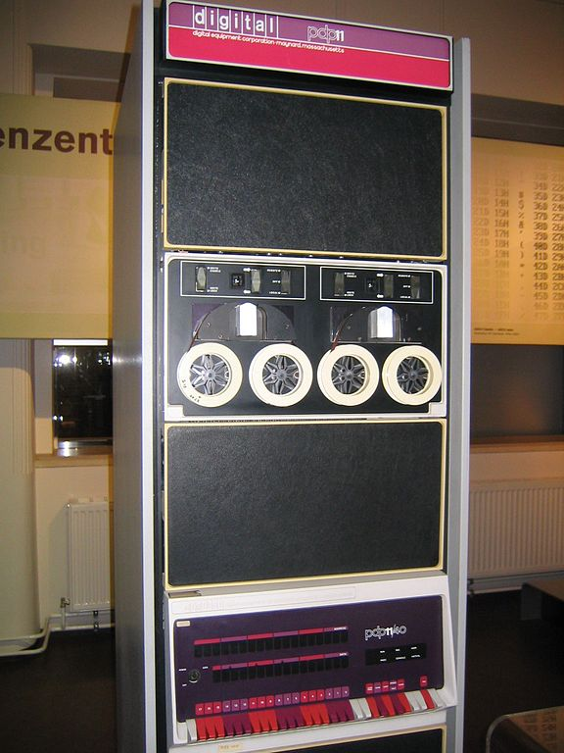
Source: Wikipedia
Source: Wikipedia (PDP-11)

Slide 8

Source: Wikipedia (Personal computer)

Slide 9

Source: Wikipedia

Slide 10
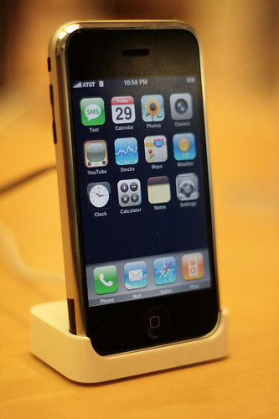
Source: Wikipedia

Slide 11
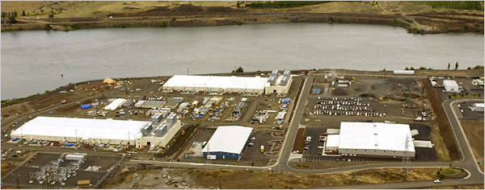
Source: NY Times (6/14/2006)

Slide 12
Introduction (How I got here)

Slide 13
Introduction (How you got here)

Slide 14
This course is about programming
(but the goal is not to make you into a programmer)

Slide 15

Agility
Source: Wikipedia (Cheetah

Slide 16
Computing

Slide 17
What is a computer?
Memory
Processor
Output
Input

Slide 18
The Processing Cycle
Input comes from somewhere
Keyboard, mouse, touchpad, touch screen, microphone, camera, …
Fetch data from memory
The computer does something with it
Add, subtract, multiply, etc.
Output goes somewhere
Monitor, speaker, printer, robot controls, …
Store data back into memory

Slide 19
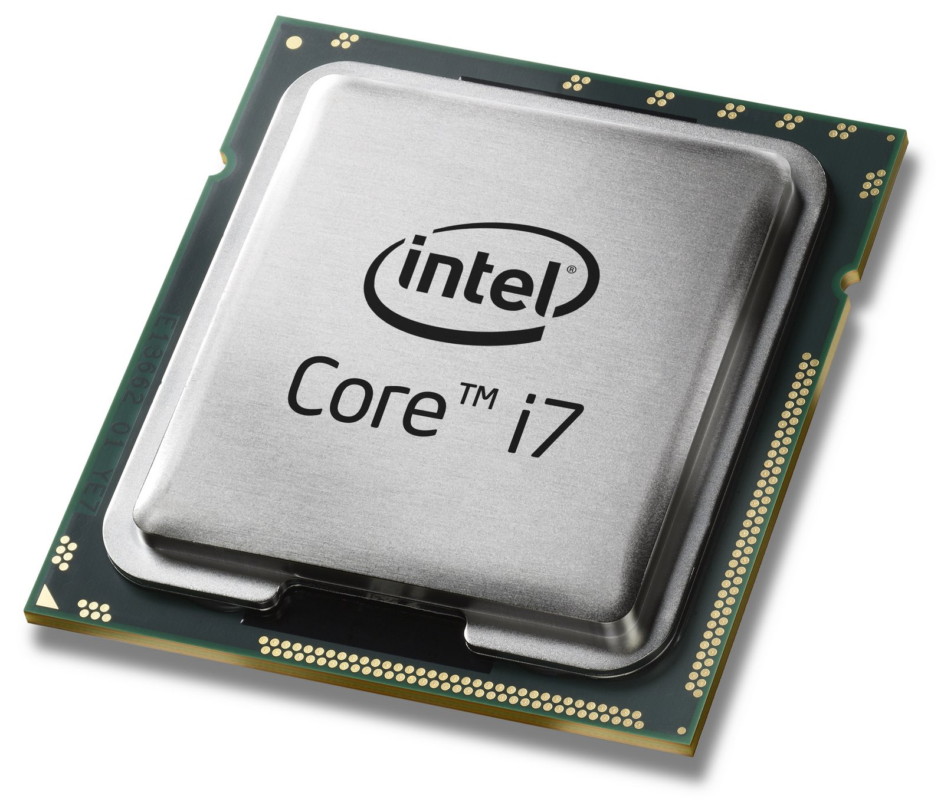
Source: Intel

Slide 20
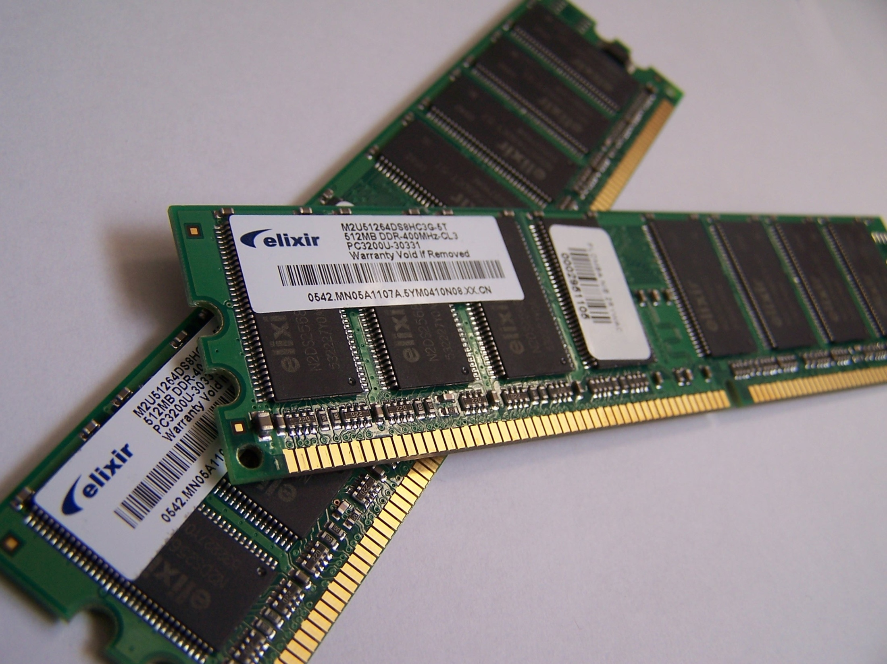
Source: Wikipedia (Random-access memory)

Slide 21
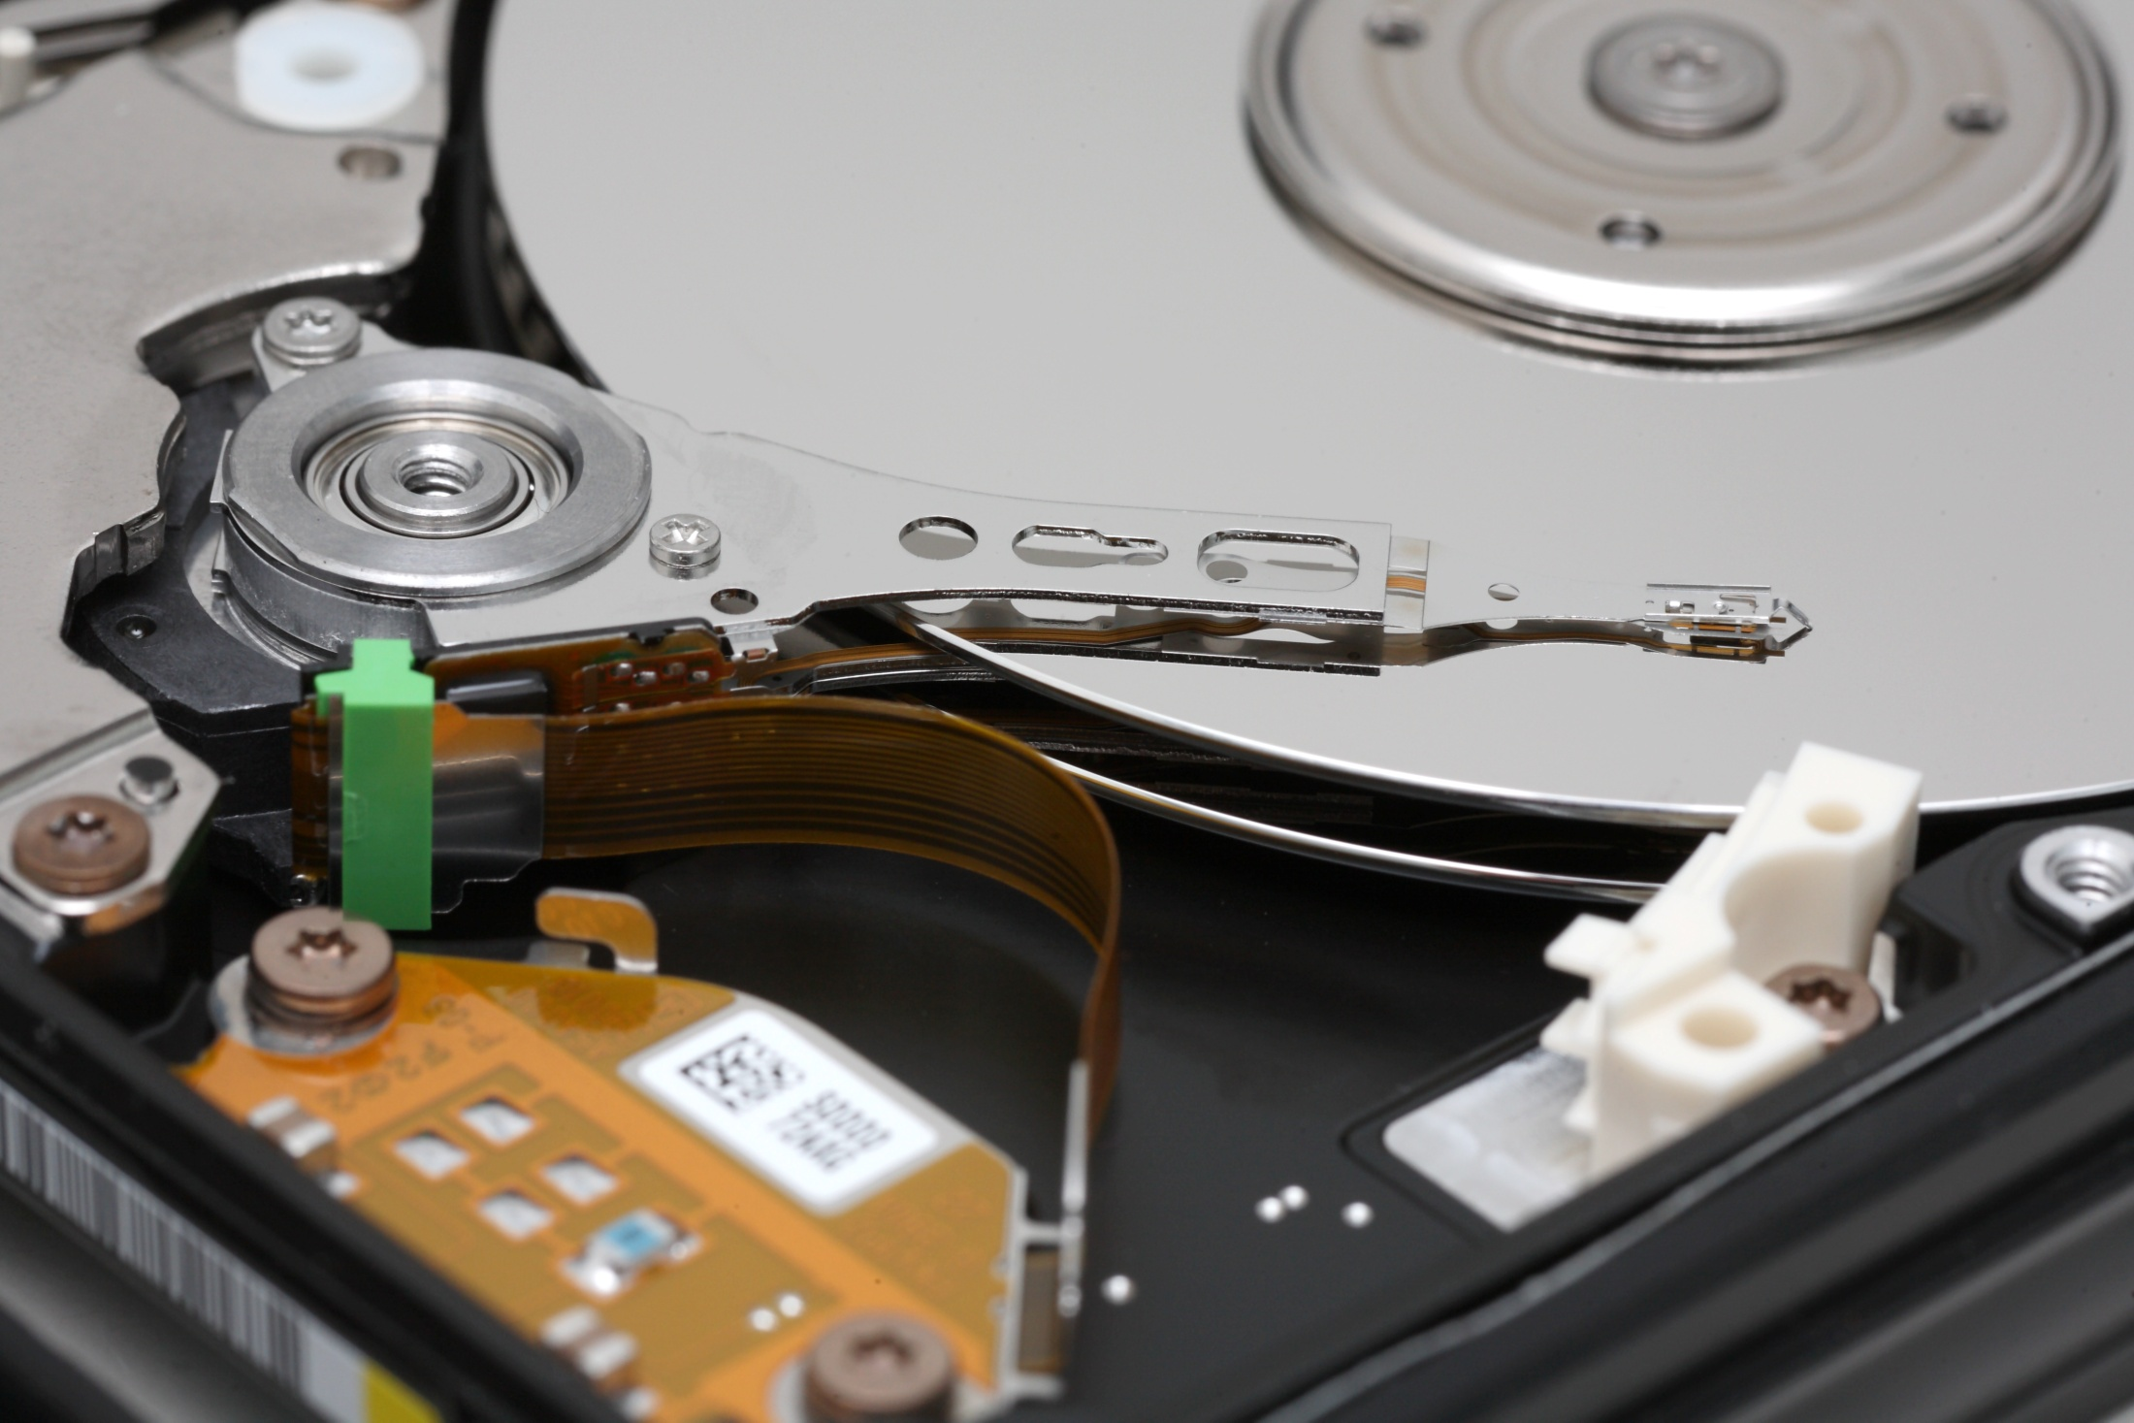
Source: Wikipedia

Slide 22
Networking

Slide 23
Why Networking?
Sharing data
Sharing hardware
Sharing software
Increasing robustness
Facilitating communications
Facilitating commerce

Slide 24
How did it all start?
How did it evolve?
How did we get here?

Slide 25
Packet vs. Circuit Networks
Telephone system (“circuit-switched”)
Fixed connection between caller and called
High network load results in busy signals
Internet (“packet-switched”)
Each transmission is broken up into pieces and routed separately
High network load results in long delays

Slide 26
Packet Switching
Break long messages into short “packets”
Keeps one user from hogging a line
Each packet is tagged with where it’s going
Route each packet separately
Each packet often takes a different route
Packets often arrive out of order
Receiver must reconstruct original message
How do packet-switched networks deal with continuous data?
What happens when packets are lost?

Slide 27
Different Networks Types
Local Area Networks (LANs)
Connections within a building or a small area
Wireless or wired
Wide Area Networks (WANs)
Connections between multiple LANs
May cover thousands of square miles
The Internet
Collection of WANs across multiple organizations

Slide 28
The Internet
Global collection of public networks
Private networks are often called “intranets”
Use of shared protocols
TCP/IP (Transmission Control Protocol/Internet Protocol): basis for communication
DNS (Domain Name Service): basis for naming computers on the network
HTTP (HyperText Transfer Protocol): World Wide Web
Next week: how does all of this work?

Slide 29
Characterizing Computing

Slide 30
Trends in Computing: #1

Slide 31
Trends in Computing: #2

Slide 32
Trends in Computing: #3

Slide 33
Ways to characterize computing
How big?
How fast?
How reliable?
Computing is fundamentally about tradeoffs!

Slide 34
How big?

Slide 35
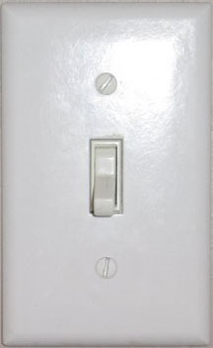

Slide 38
How many states can n bits represent?
(or the story of 18,446,744,073,709,551,615 grains of rice)

Slide 39


Slide 40
Data is represented via an encoding
American Standard Code for Information Interchange (ASCII)
= standard byte encoding used in PC’s
01000001 = A
01000010 = B
01000011 = C
01000100 = D
01000101 = E
01000110 = F
01000111 = G
01001000 = H
01001001 = I
01001010 = J
01001011 = K
01001100 = L
01001101 = M
01001110 = N
01001111 = O
01010000 = P
01010001 = Q
…
01100001 = a
01100010 = b
01100011 = c
01100100 = d
01100101 = e
01100110 = f
01100111 = g
01101000 = h
01101001 = i
01101010 = j
01101011 = k
01101100 = l
01101101 = m
01101110 = n
01101111 = o
01110000 = p
01110001 = q
…

Slide 41
Units of Size
Unit | Abbreviation | Size (bytes)
bit | b | 1/8
byte | B | 1
kilobyte | KB | 2¹⁰ = 1,024
megabyte | MB | 2²⁰ = 1,048,576
gigabyte | GB | 2³⁰ = 1,073,741,824
terabyte | TB | 2⁴⁰ = 1,099,511,627,776
petabyte | PB | 2⁵⁰ = 1,125,899,906,842,624
In most cases, it’s okay to approximate!

Slide 42
How fast?

Slide 43
Thinking About Speed
Speed can be expressed in two ways:
How many things can you do in one second?
How long to do something once?
Convenient units are typically used
1 GHz instead of 1,000,000,000 Hz
10 microseconds rather than 0.00001 seconds
When comparing measurements, convert units first!

Slide 44
Units of Frequency
Unit | Abbreviation | Cycles per second
hertz | Hz | 1
kilohertz | KHz | 10³ = 1,000
megahertz | MHz | 10⁶ = 1,000,000
gigahertz | GHz | 10⁹ = 1,000,000,000

Slide 45
Units of Time
Unit | Abbreviation | Duration (seconds)
second | sec/s | 1
millisecond | ms | 10⁻³ = 1/1,000
microsecond | μs | 10⁻⁶ = 1/1,000,000
nanosecond | ns | 10⁻⁹ = 1/1,000,000,000
picosecond | ps | 10⁻¹² = 1/1,000,000,000,000
femtosecond | fs | 10⁻¹⁵ = 1/1,000,000,000,000,000
How far does light travel in one nanosecond?
0.3048 m

Slide 46
How fast can we compute?
Computation speed is limited by two factors:
Getting data to the CPU
Operating on the data in the CPU
Two parts of moving data from here to there:
The delay between two locations
Amount of data you can move within a given amount of time
Fundamentally, there’s no difference:
Moving data from the processor to RAM
Saving a file to disk
Watching Netflix

Slide 47
Latency
Units in terms of time
Bandwidth
Units in terms of size per time

Slide 48
Discussion Point
What’s more important: latency or bandwidth?
Streaming audio (e.g., NPR broadcast over Web)
Streaming video (e.g., CNN broadcast over Web)
Audio chat
Video conferencing

Slide 49
How reliable?

Slide 50
Characterizing Reliability
“Nines” | Availability | Downtime (per year)
One nine | 90% | 36.5 d
Two nines | 99% | 3.65 d
Three nines | 99.9% | 8.76 h
Four nines | 99.99% | 52.56 m
Five nines | 99.999% | 5.256 m
Six nines | 99.9999% | 31.536 s

Slide 51
Time to roll up your sleeves…

Slide 52

Server (Web? File?)
Source: http://www.studyzone.org/

Slide 53

Clients
Source: http://www.netofinancial.com/

Slide 54
Why Code HTML by Hand?
The only way to learn is by doing
WSIWYG editors…
Often generate unreadable code
Ties you down to that particular editor
Cannot help you manipulate backend databases
Little help when it comes to Javascript
Hand coding HTML allows you to have finer-grained control
HTML is demonstrative of other important concepts:
Structured documents
Markup
Metadata
…

Slide 55
Tips
Edit files on your own machine, upload when you’re happy
Save early, save often, just save!
Reload browser
File naming
Don’t use spaces!
Punctuation matters!

